Slide 1


LEON HEALTH CARE SYSTEM

Slide 2
Project Members
Gaurav Chand Singh
Janhavi Singh Chauhan
Lavi Katiyar
Anand Thakur
Ishita Singh

Slide 3
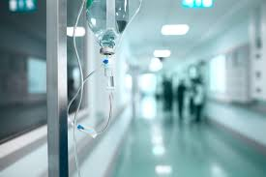
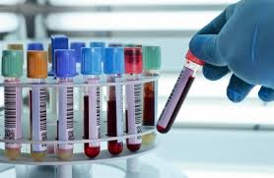


INTRODUCTION
We aim to create a user-friendly application for a Health Care System.
The system consists of various diagnostic centers, with their own tests and appointments which the customers can opt for.
We tend to elevate the current scenario of health care systems by consistently operating at customer’s disposal.

Slide 4





Technology and Software Used
Spring Tool Suite
Visual Code Studio
Postman
Oracle 11g
H2 Database

Slide 5
USE CASES
To gather design requirements of a system
Understands system processes and patterns
Shows different types of roles, actions and their interaction
Identifies the external and internal factors influencing the system
Defines the scope of the project

Slide 6
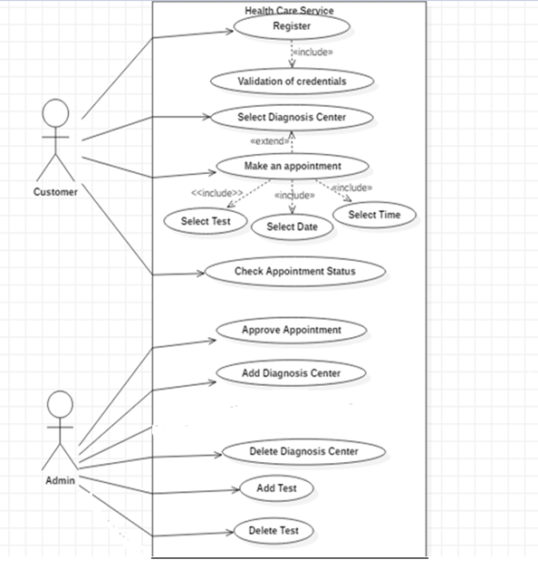
USE CASE DIAGRAM

Slide 7
Use Case Analysis
Actors
Admin
Approve Appointment
Add Diagnostic Center
Customer
Check Appointment Status
Select Diagnostic Center
Add Test
Delete Diagnostic Center
Delete Test
Register
Select Test, Date, Time
Make Appointment

Slide 8

CLASS DIAGRAM
The purpose of the diagram is to show and explain the structure, functions, relationships, classes, attributes & related terminologies.

Slide 9
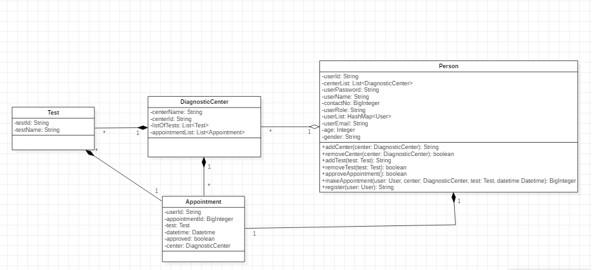
CLASS DIAGRAM
.
.

Slide 10
SEQUENCE DIAGRAM
It represents a timeline which begins at the top and descends gradually to mark the sequence of interactions, using the vertical axis of the diagram to represent time what messages are sent and when.

Slide 11
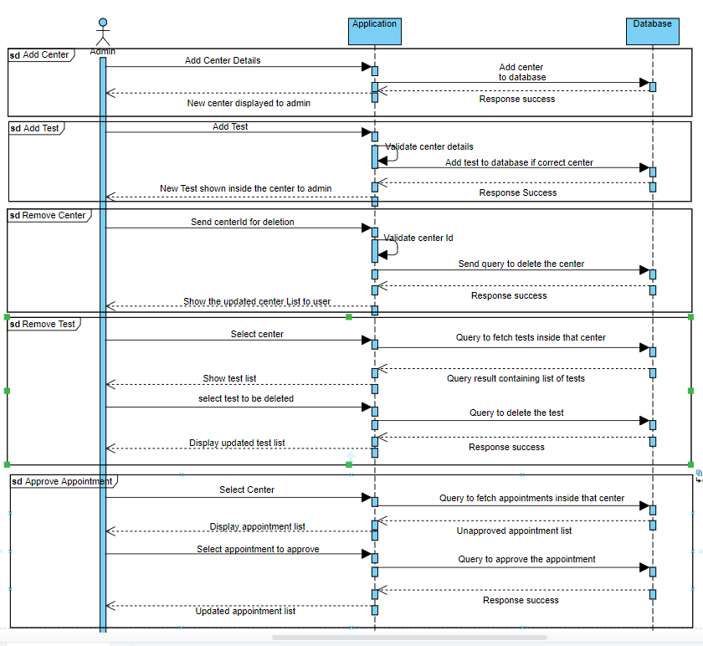
Sequence Diagram (Admin)

Slide 12
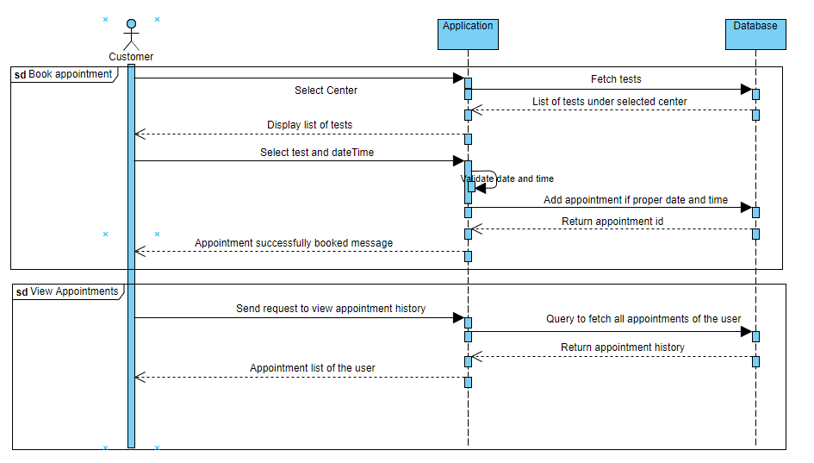
Sequence Diagram (Customer)

Slide 13
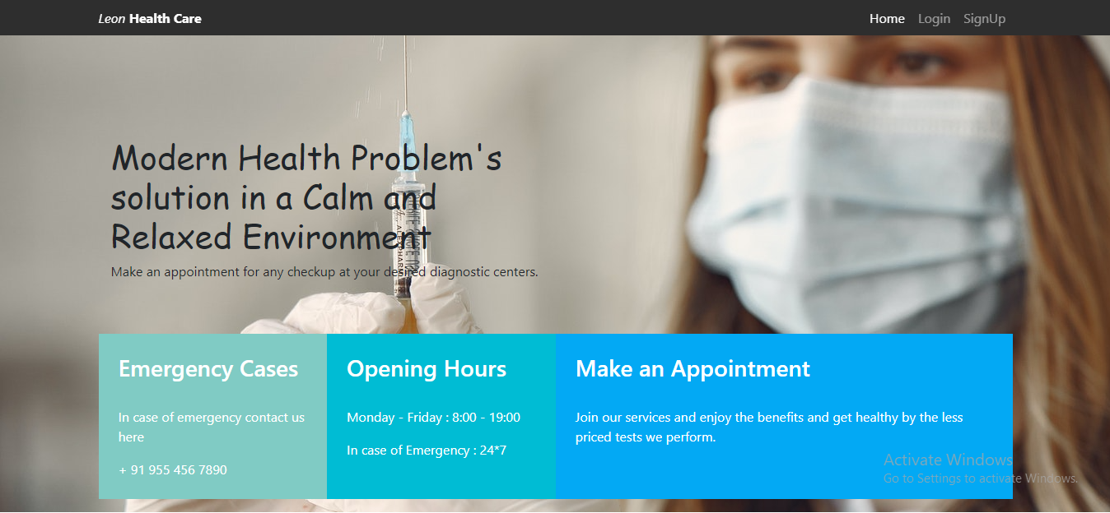
Glimpse of Project
.

Slide 14
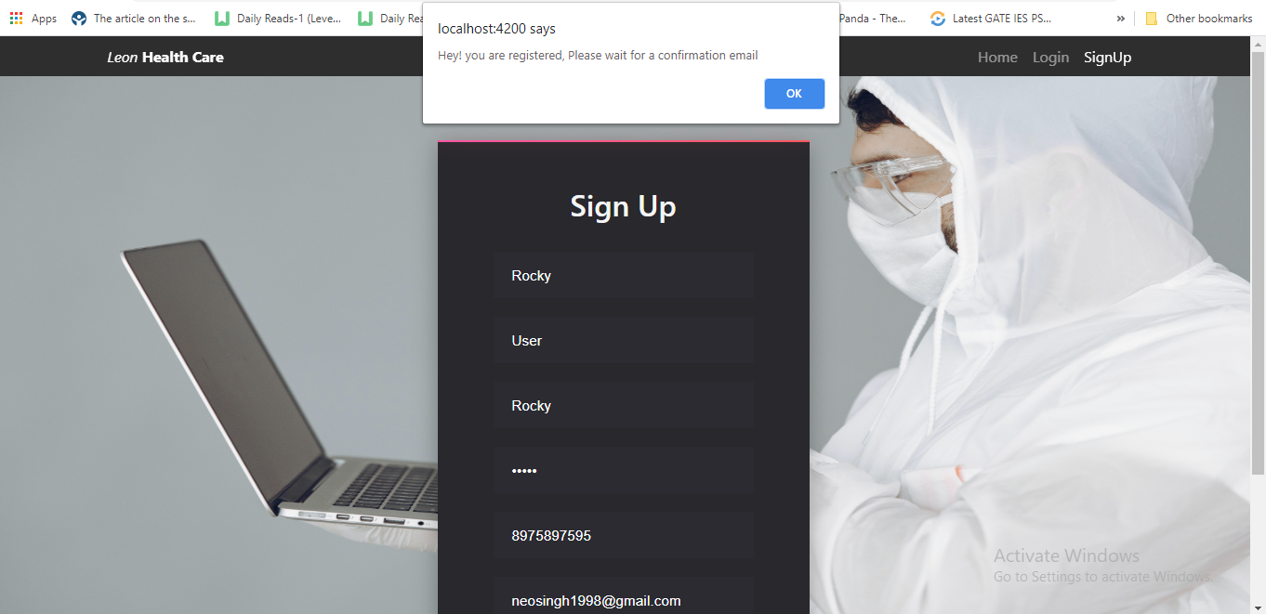
UI

Slide 15
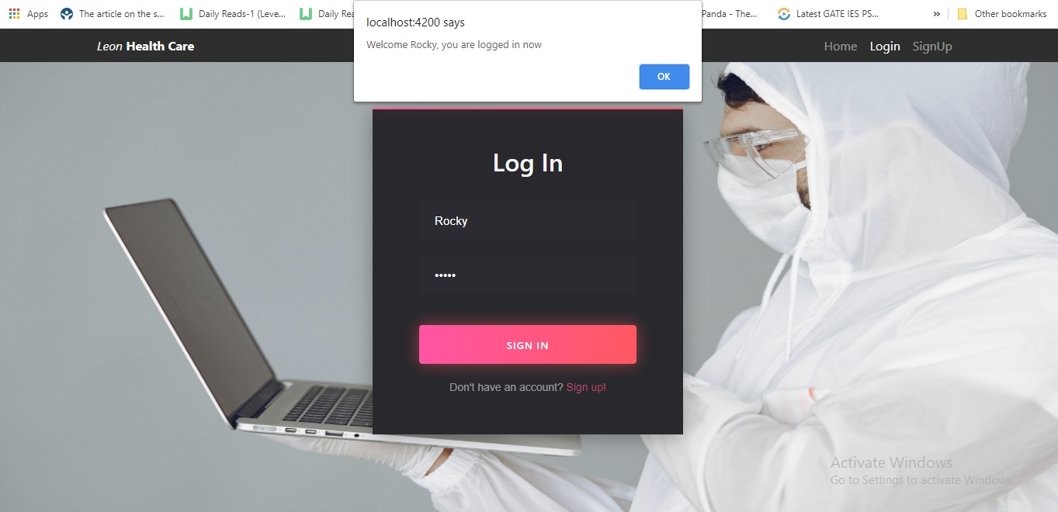
UI

Slide 16
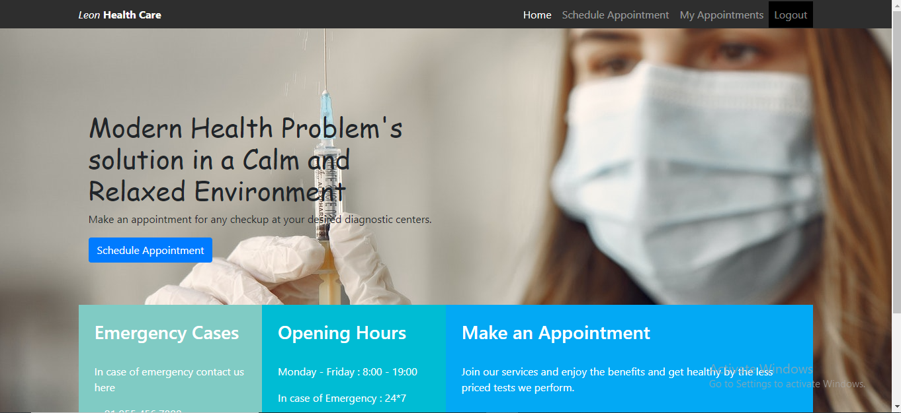
UI

Slide 17
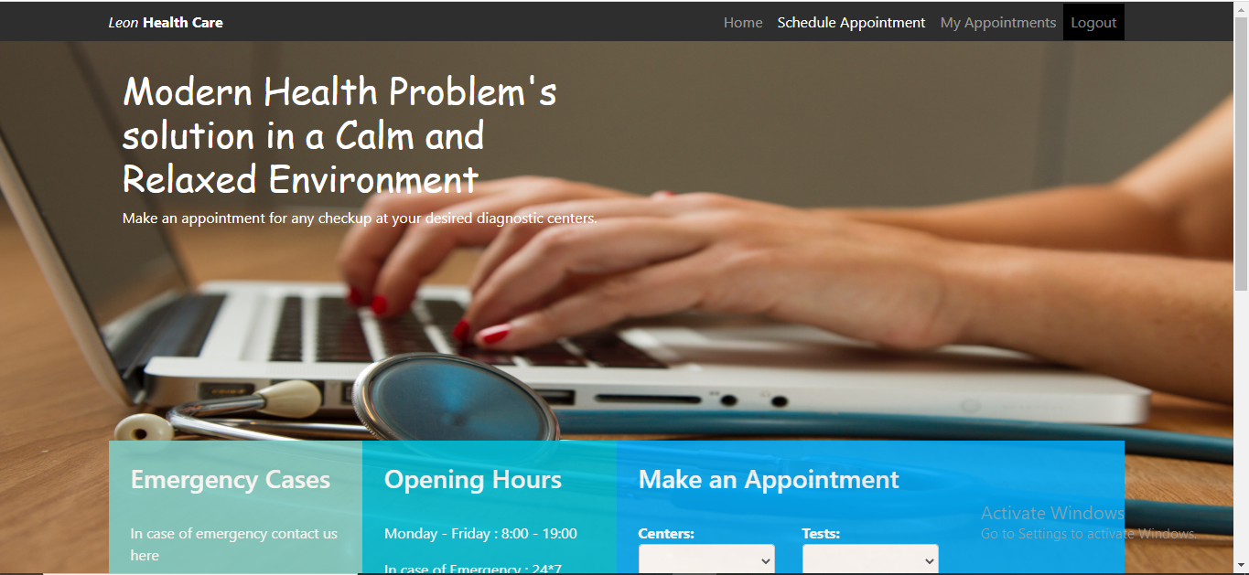

Slide 18
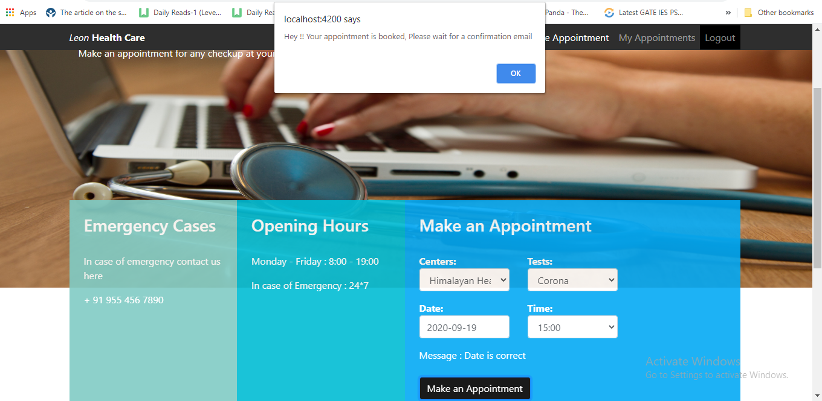

Slide 19
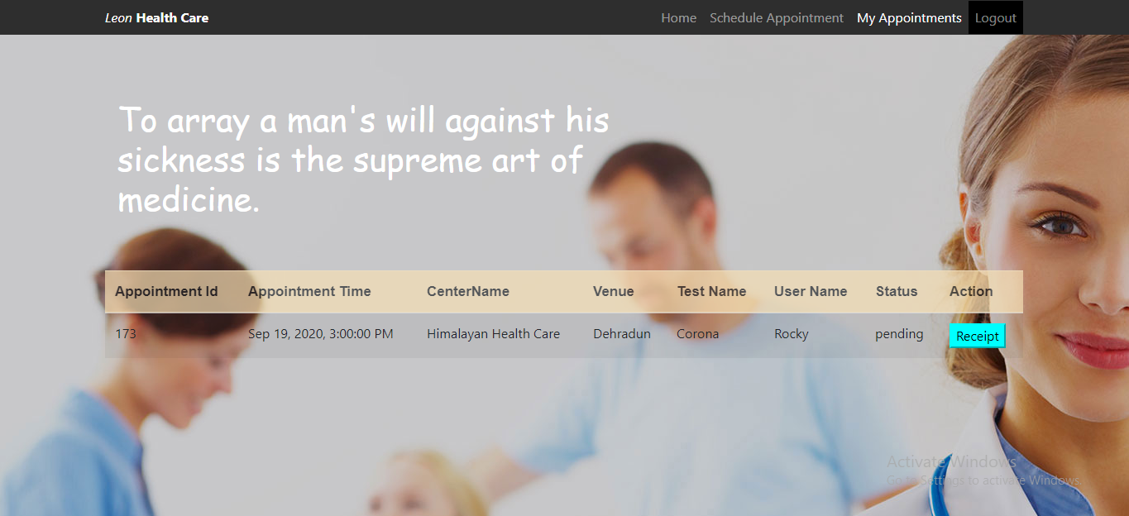

Slide 20
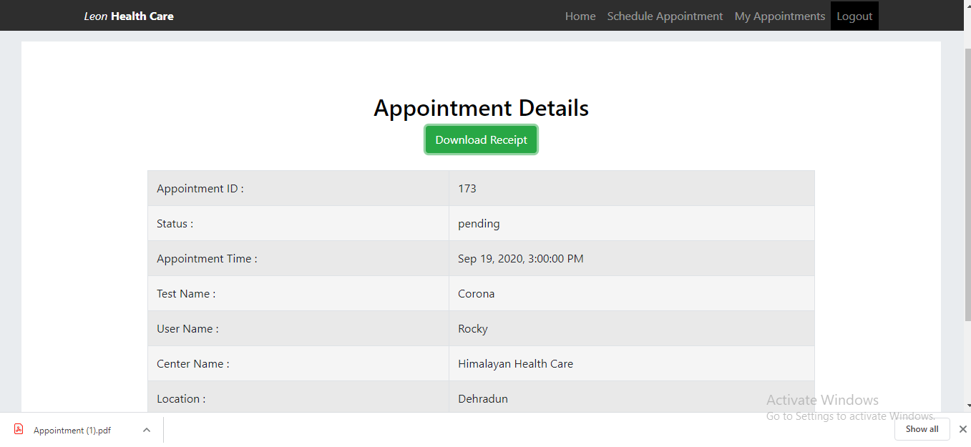

Slide 21
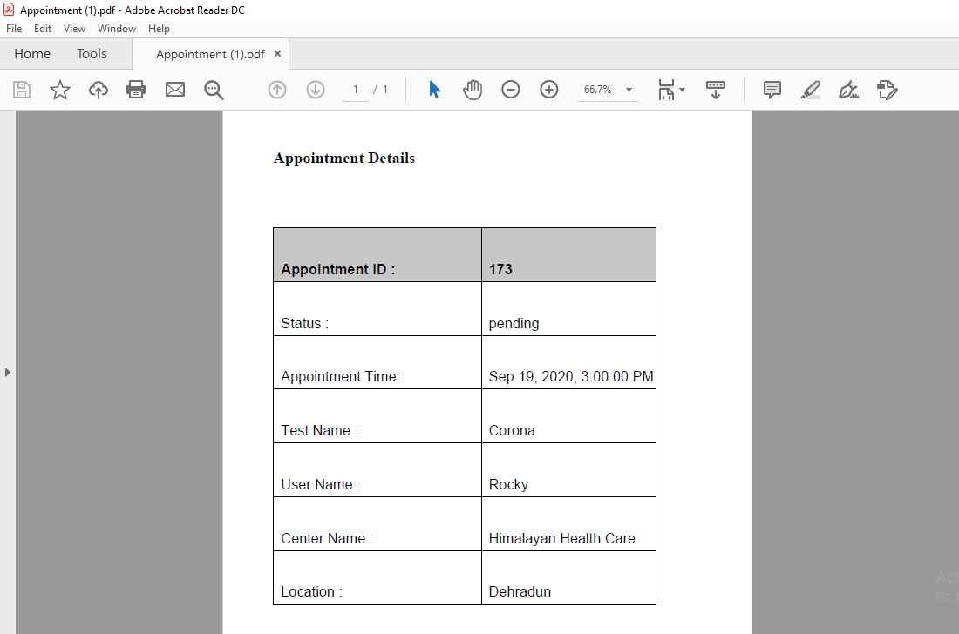

Slide 22
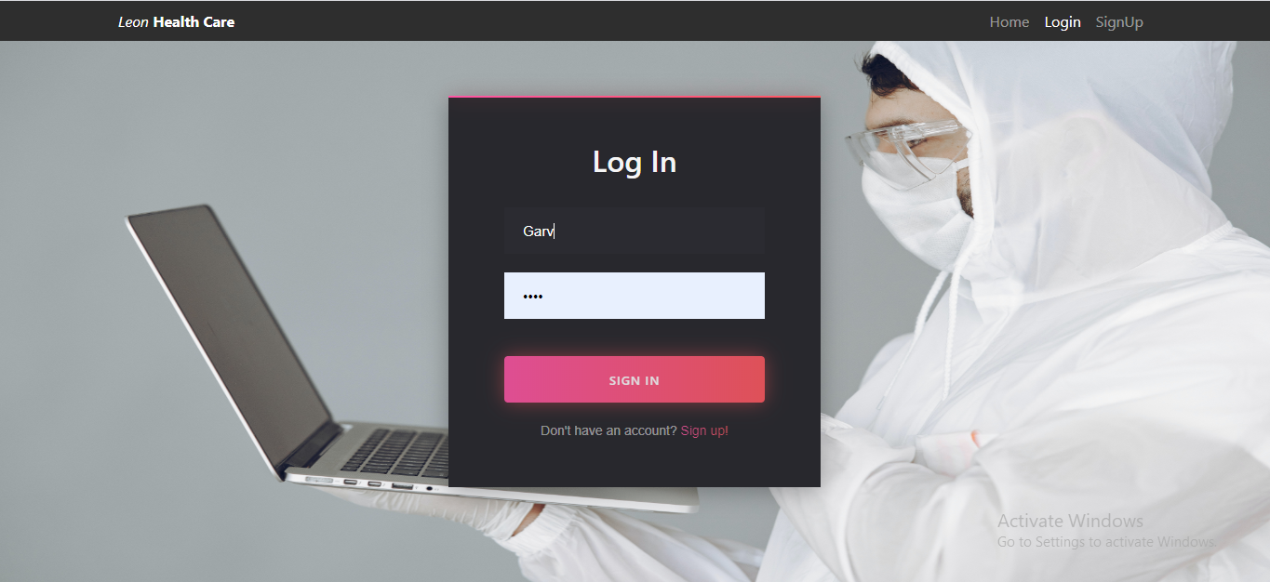

Slide 23
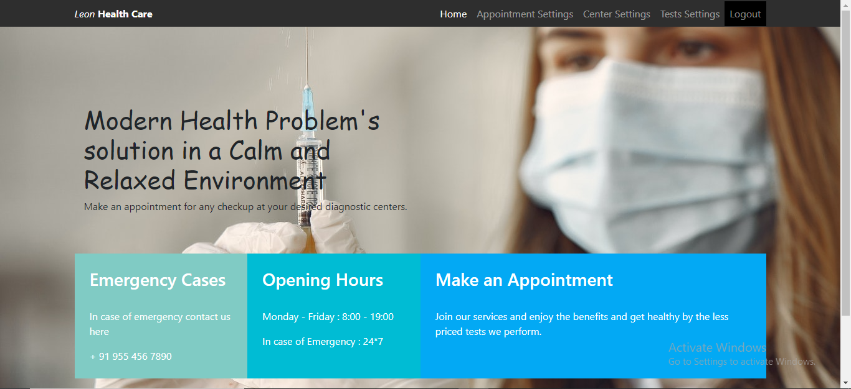

Slide 24
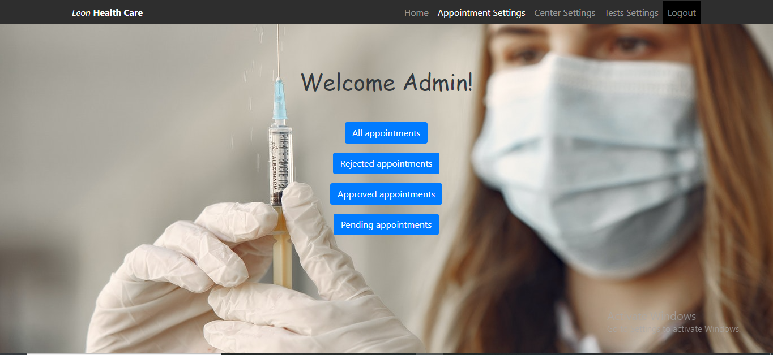

Slide 25
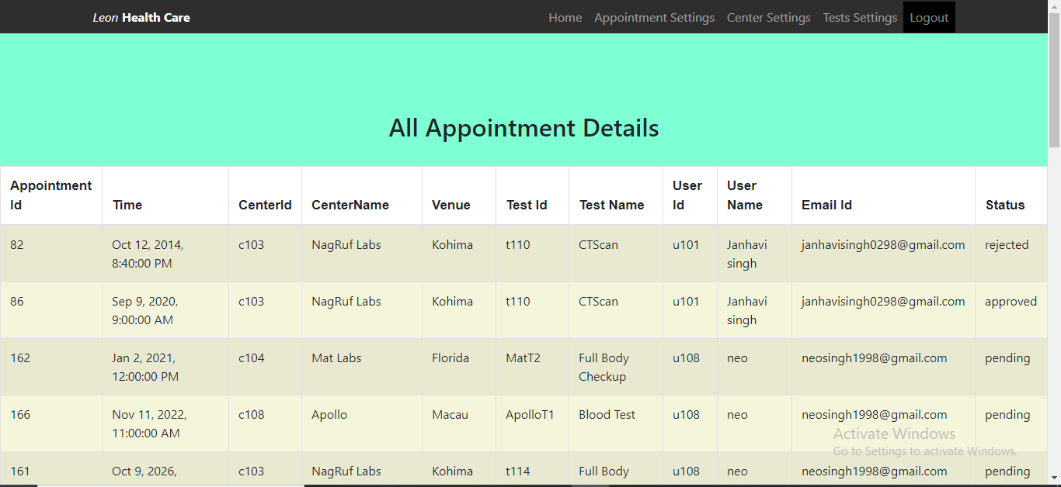

Slide 26
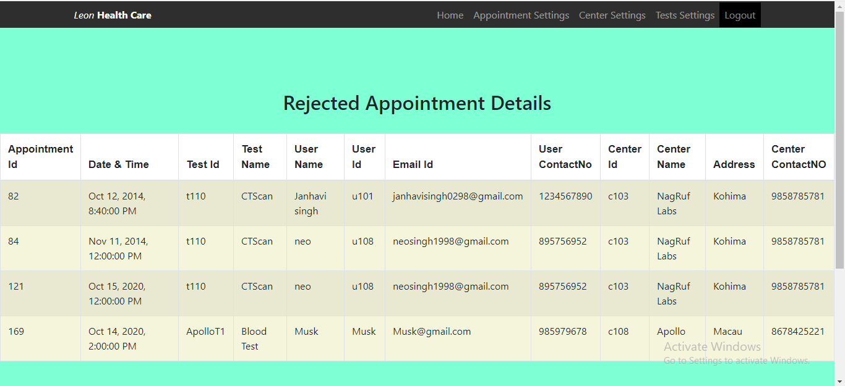

Slide 27
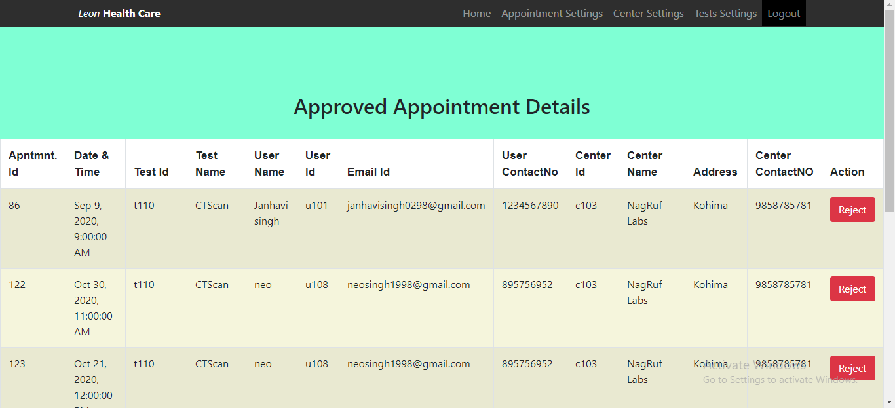

Slide 28
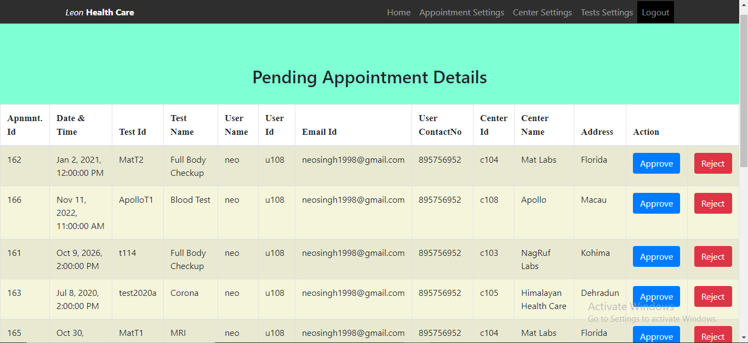

Slide 29
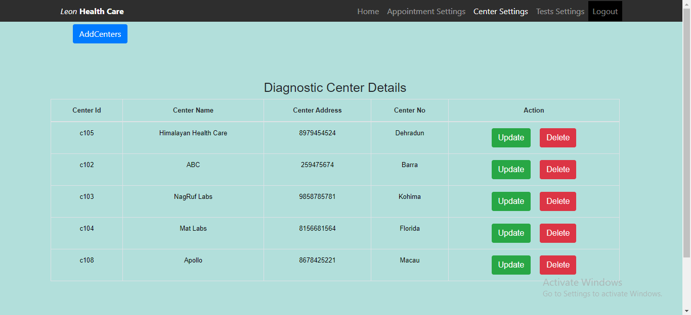

Slide 30
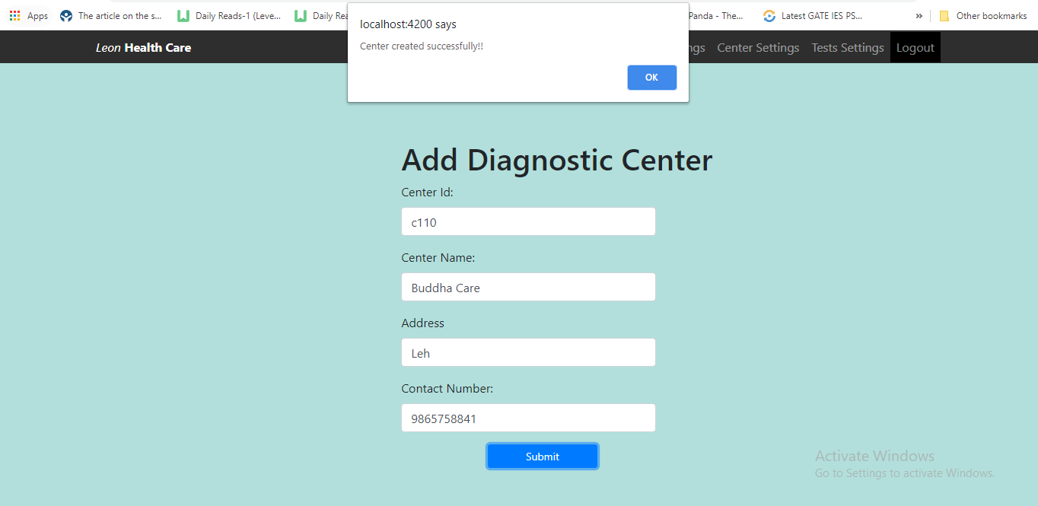

Slide 31
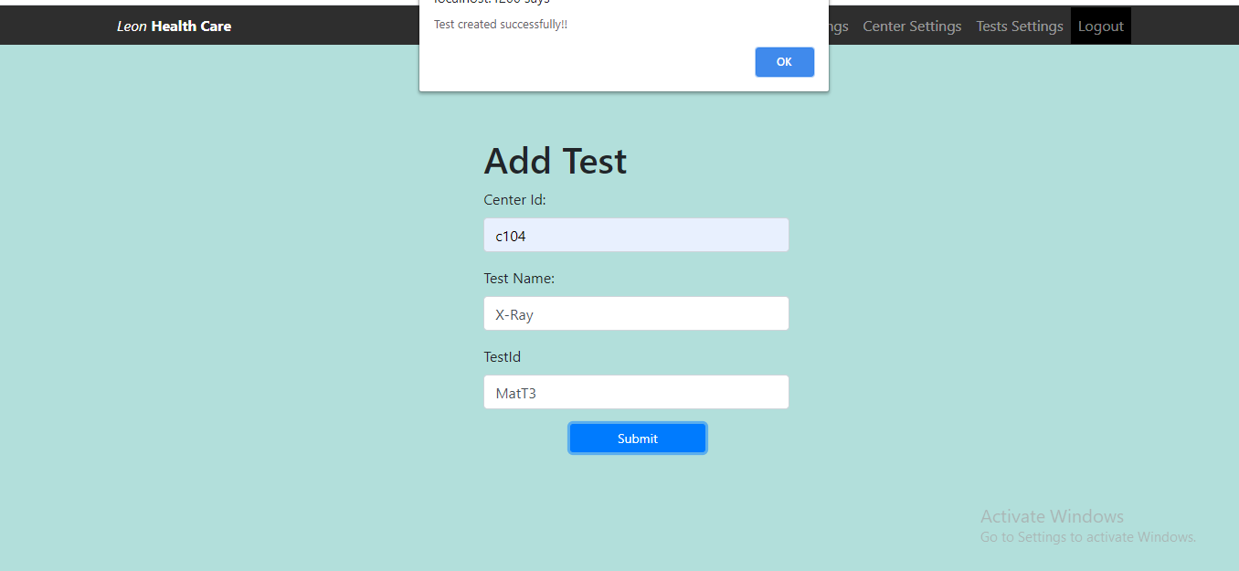

Slide 32
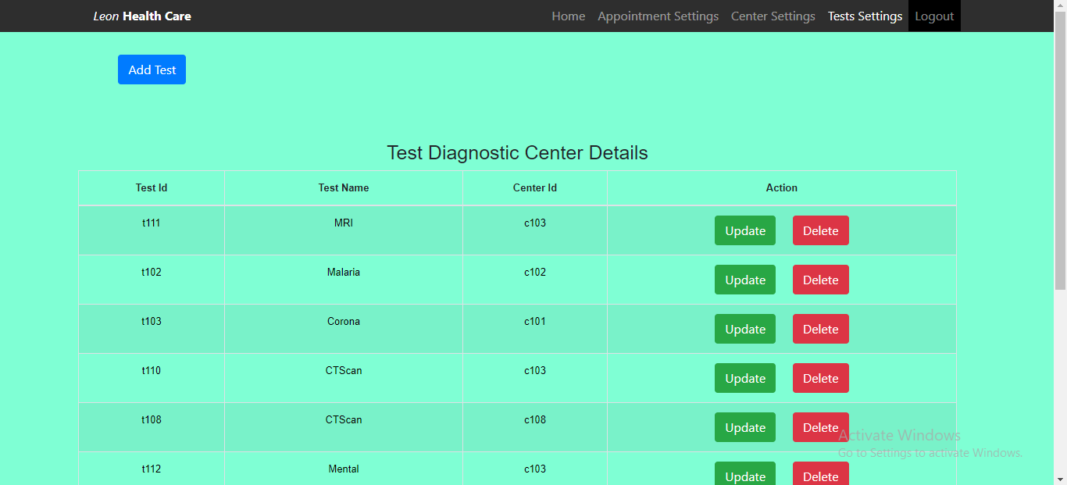

Slide 33
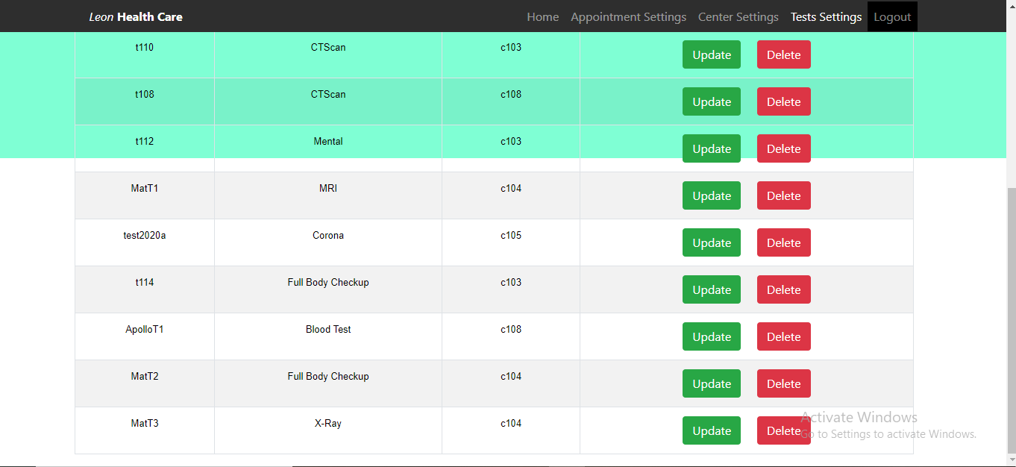

Slide 34

Thank You!

